Slide 1
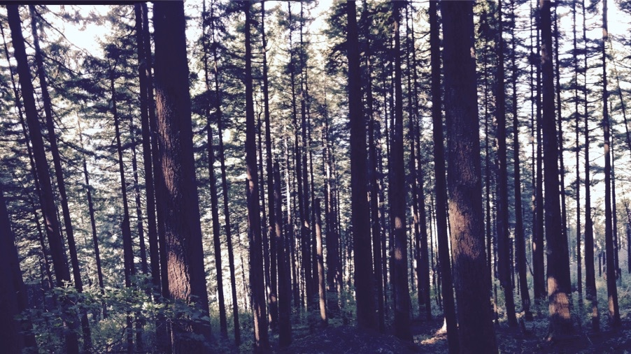
Using least cost optimality to reliably simulate photosynthetic acclimation
Nick Smith
Department of Biological Sciences
Texas Tech University

Slide 2
Plants acclimate to environmental conditions
nick.smith@ttu.edu; @nick_greg_smith
Level of operation
Population
Plant
Acclimation
Leaf
Instantaneous response
Cell
Seconds
Minutes
Days
Years
Response time
Smith and Dukes (2013)

Slide 3
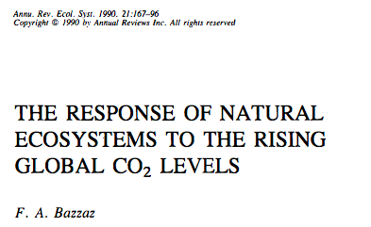
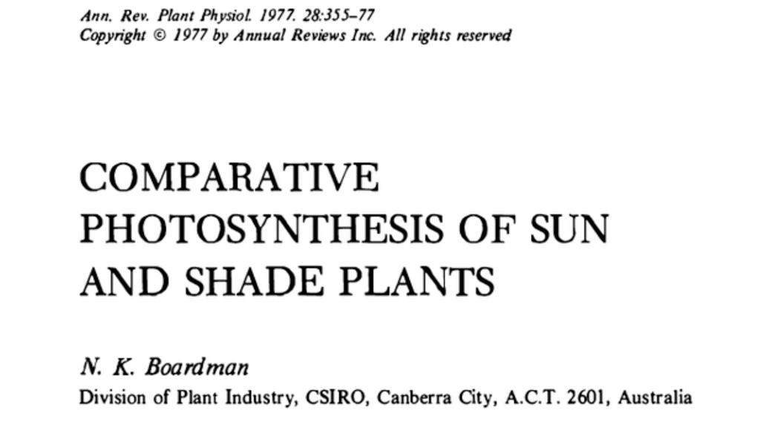
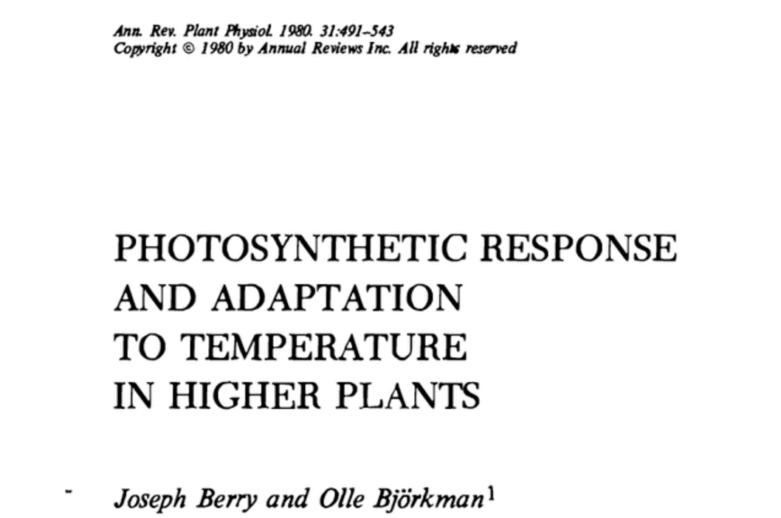
Photosynthetic acclimation is ubiquitous and well known…
nick.smith@ttu.edu; @nick_greg_smith
Temperature: Berry & Björkman (1980)
CO₂: Bazzaz (1990)
Light: Boardman (1977)

Slide 4
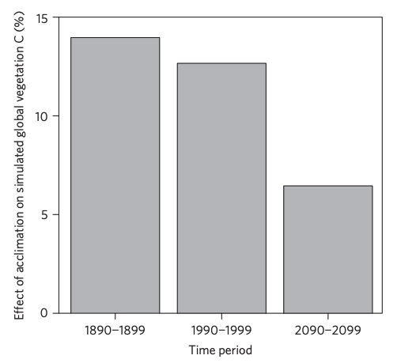
…and can possibly impact carbon cycling and climate
nick.smith@ttu.edu; @nick_greg_smith
Acclimation increase future C storage by ~6%
Acclimation alters future temperature by >1°C
Smith et al. (2017) Nature Climate Change
Smith et al. (2017) JAMES

Slide 5
Here’s the problem: No theoretical model for photosynthetic acclimation exists
nick.smith@ttu.edu; @nick_greg_smith

Slide 6
Lack of theory results in…
nick.smith@ttu.edu; @nick_greg_smith

Slide 7
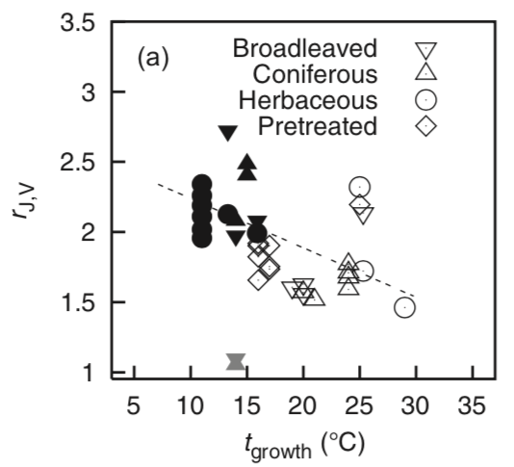
Lack of theory results in…
nick.smith@ttu.edu; @nick_greg_smith
Unreliable future predictions (overparameterization, tuning)
Reliance on statistical models
Resulting change in simulated photosynthesis
Physiological parameter
Environmental condition
Kattge and Knorr (2007) PC&E
Smith et al. (2017) JAMES

Slide 8
So, we developed a mechanistic model of photosynthetic acclimation Based on least cost optimization and the first principles of plant physiological theory
nick.smith@ttu.edu; @nick_greg_smith

Slide 9
Least cost theory
nick.smith@ttu.edu; @nick_greg_smith
Maintain fastest rate of photosynthesis at the lowest cost (water and nutrient use)
Wright et al. (2003) American Naturalist

Slide 10
Optimal photosynthesis
nick.smith@ttu.edu; @nick_greg_smith
Photosynthesis = f{stomatal conductance,
photosynthetic biochemistry}

Slide 11
Optimal photosynthesis
nick.smith@ttu.edu; @nick_greg_smith
Photosynthesis = f{stomatal conductance,
photosynthetic biochemistry}
Must predict optimal rates of both

Slide 12
Optimal photosynthesis
nick.smith@ttu.edu; @nick_greg_smith
Photosynthesis = f{stomatal conductance,
photosynthetic biochemistry}

Slide 13
Optimal photosynthesis
nick.smith@ttu.edu; @nick_greg_smith
Photosynthesis = f{stomatal conductance,
photosynthetic biochemistry}
OTPIMAL CONDUCTANCE IS NOW INCLUDED IN MANY MODELS
e.g., Prentice et al. (2014), Medlyn et al. (2011)

Slide 14
Optimal photosynthesis
nick.smith@ttu.edu; @nick_greg_smith
Photosynthesis = f{stomatal conductance,
photosynthetic biochemistry}

Slide 15
Biochemistry optimization: Coordination hypothesis
nick.smith@ttu.edu; @nick_greg_smith
Optimal setup = equal limitation by all factors

Slide 16
Optimally: electron transport-limited (A_{j}) = Rubisco-limited (A_{c})
nick.smith@ttu.edu; @nick_greg_smith
A_{j} = A_{c}
A_{j} = f{light, T, CO₂}
A_{c} = f{V_{cmax}, T, CO₂}
Smith et al. (2019)

Slide 17
nick.smith@ttu.edu; @nick_greg_smith
V_{cmax} = f {light, T, CO₂}
Smith et al. (2019)

Slide 18
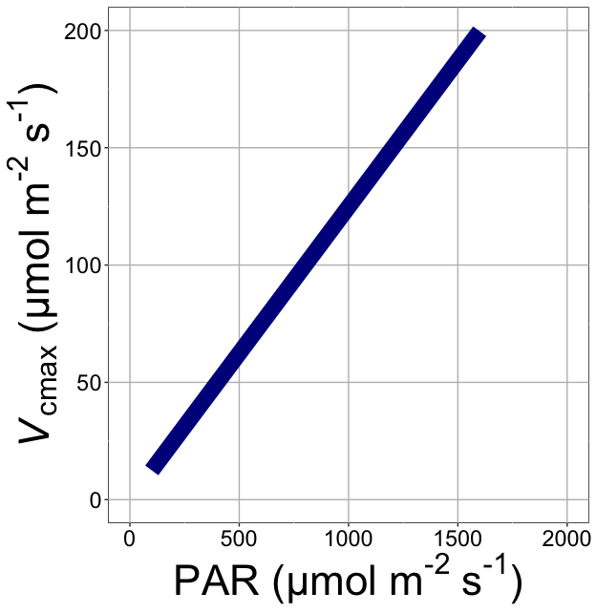
nick.smith@ttu.edu; @nick_greg_smith
V_{cmax} increases with light because of greater electron transport
Smith et al. (2019)

Slide 19
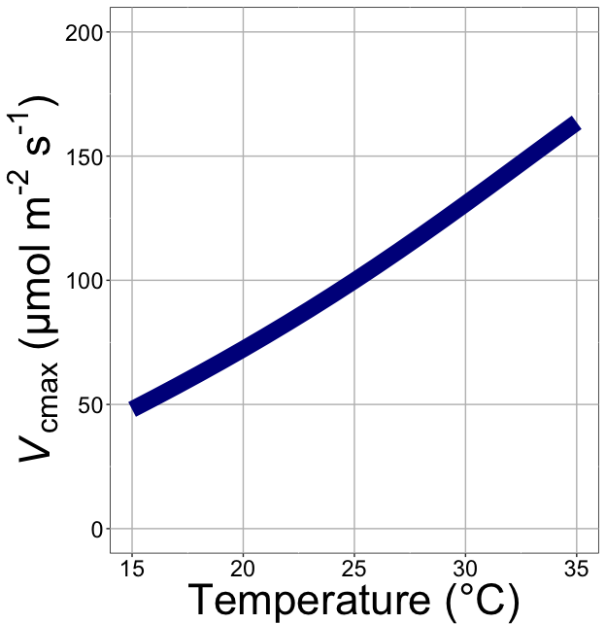
nick.smith@ttu.edu; @nick_greg_smith
V_{cmax} increases with temperature because of greater electron transport and photorespiration
Smith et al. (2019)

Slide 20
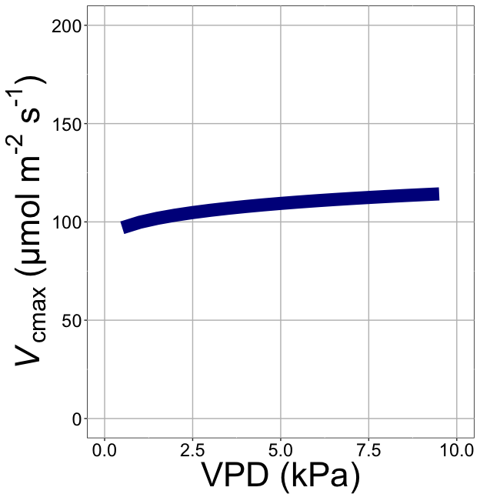
nick.smith@ttu.edu; @nick_greg_smith
V_{cmax} increases with VPD because of lower stomatal conductance
Smith et al. (2019)

Slide 21
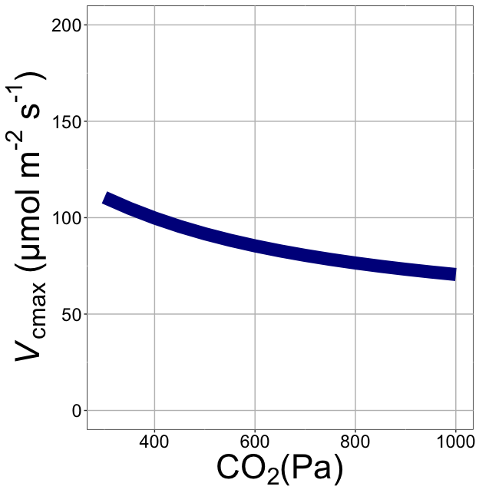
nick.smith@ttu.edu; @nick_greg_smith
V_{cmax} decreases with CO₂ because of greater CO₂ in the leaf
(ppm)
Smith et al. (2019)

Slide 22
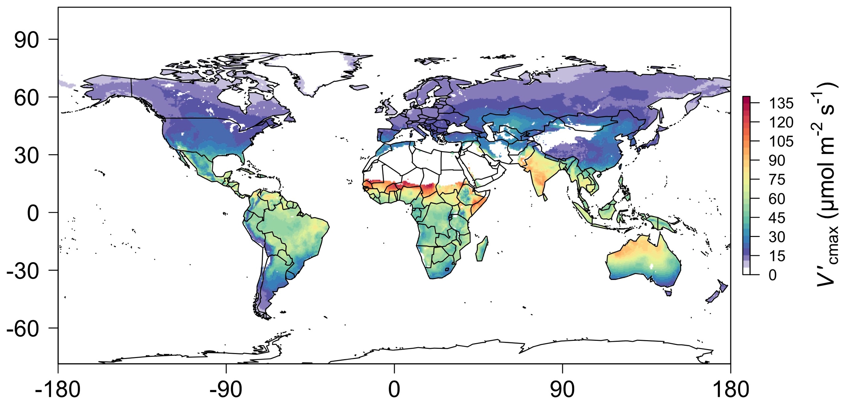
nick.smith@ttu.edu; @nick_greg_smith
Global, optimally acclimated traits!
Smith et al. (2019)

Slide 23
Important note: optimality model adds no free parameters to Farquhar model and dynamically predicts most
nick.smith@ttu.edu; @nick_greg_smith

Slide 24
Important note: adds acclimation, while reducing parametric uncertainty
nick.smith@ttu.edu; @nick_greg_smith

Slide 25

Let’s run a model out into the future!
nick.smith@ttu.edu; @nick_greg_smith

Slide 26
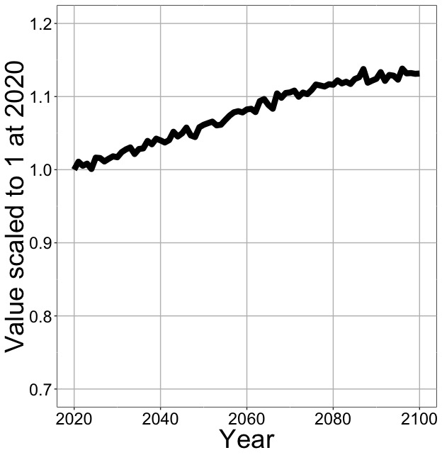
Photosynthesis increases in future
nick.smith@ttu.edu; @nick_greg_smith
Net Photosynthesis
Smith et al. (in prep)

Slide 27
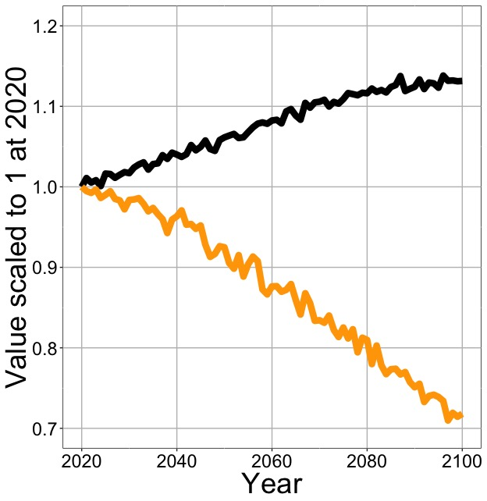
Photosynthesis increases in future (at lower nutrient use)
nick.smith@ttu.edu; @nick_greg_smith
Net Photosynthesis
Leaf Nitrogen
Smith et al. (in prep)

Slide 28
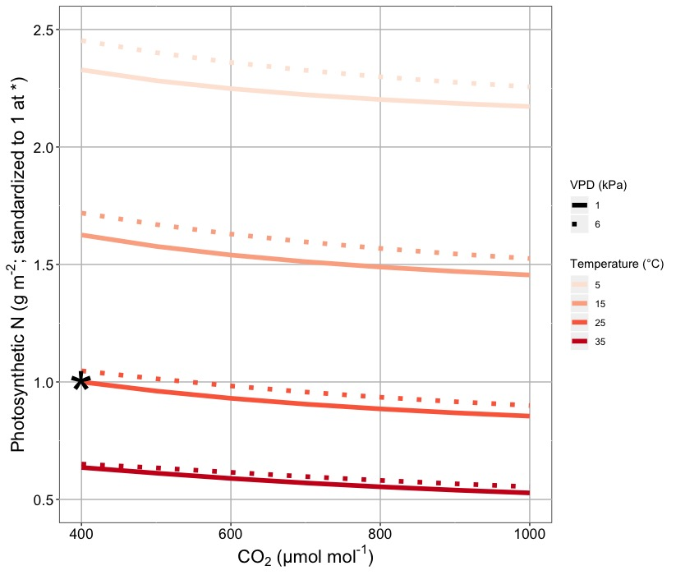
Leaf N declines due to warming and eCO₂
nick.smith@ttu.edu; @nick_greg_smith
Smith & Keenan (in review)

Slide 29
Photosynthesis increases in future (at lower nutrient use)
nick.smith@ttu.edu; @nick_greg_smith
Net Photosynthesis
Leaf Nitrogen
Smith et al. (in prep)

Slide 30
Photosynthesis increases in future (at lower nutrient use)
nick.smith@ttu.edu; @nick_greg_smith
Net Photosynthesis
Base ELM shows <5% change in leaf N
Leaf Nitrogen
Smith et al. (in prep)

Slide 31
What does this all mean and is it real?
nick.smith@ttu.edu; @nick_greg_smith

Slide 32
A typical LSM photosynthesis scheme
nick.smith@ttu.edu; @nick_greg_smith
Climate
Soil N
Leaf N
Photosynthesis

Slide 33
Least cost optimality model
nick.smith@ttu.edu; @nick_greg_smith
Climate
Photosynthesis

Slide 34
Let’s check this assumption
nick.smith@ttu.edu; @nick_greg_smith
Climate
Soil N
Leaf N
Photosynthesis

Slide 35
Does leaf N respond to soil N?
nick.smith@ttu.edu; @nick_greg_smith
Each box is proportional to the variance in leaf N explained by each variable
Smith et al. (in prep)

Slide 36
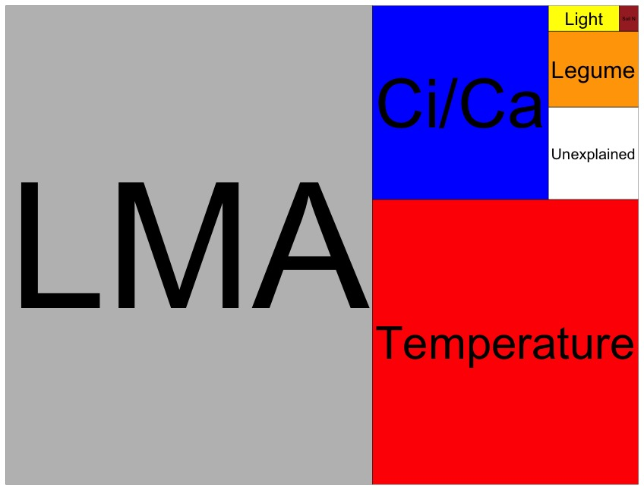
Globally, N addition little impact on leaf N
nick.smith@ttu.edu; @nick_greg_smith
Each box is proportional to the variance in leaf N explained by each variable
Smith et al. (in prep)

Slide 37
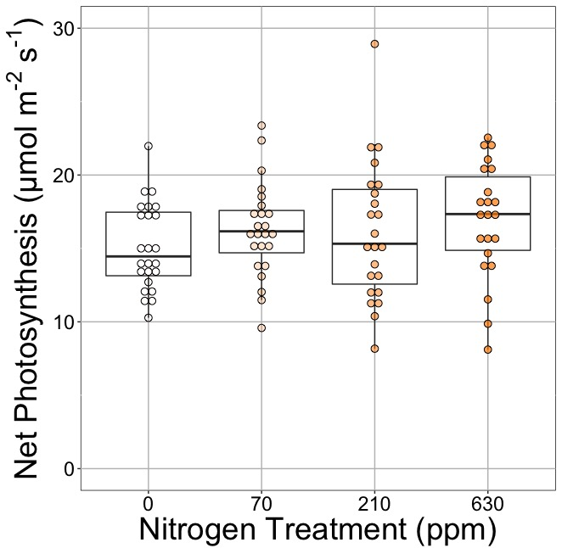
Does photosynthesis respond to soil N?
nick.smith@ttu.edu; @nick_greg_smith
Waring and Smith (in prep)

Slide 38
Photosynthesis does not change with soil N
nick.smith@ttu.edu; @nick_greg_smith
No change (P = 0.42)
Waring and Smith (in prep)

Slide 39
How does the optimality model do?
nick.smith@ttu.edu; @nick_greg_smith
Climate
Photosynthesis

Slide 40

nick.smith@ttu.edu; @nick_greg_smith
Optimal V_{cmax} is similar to observed values
Smith et al. (2019)

Slide 41
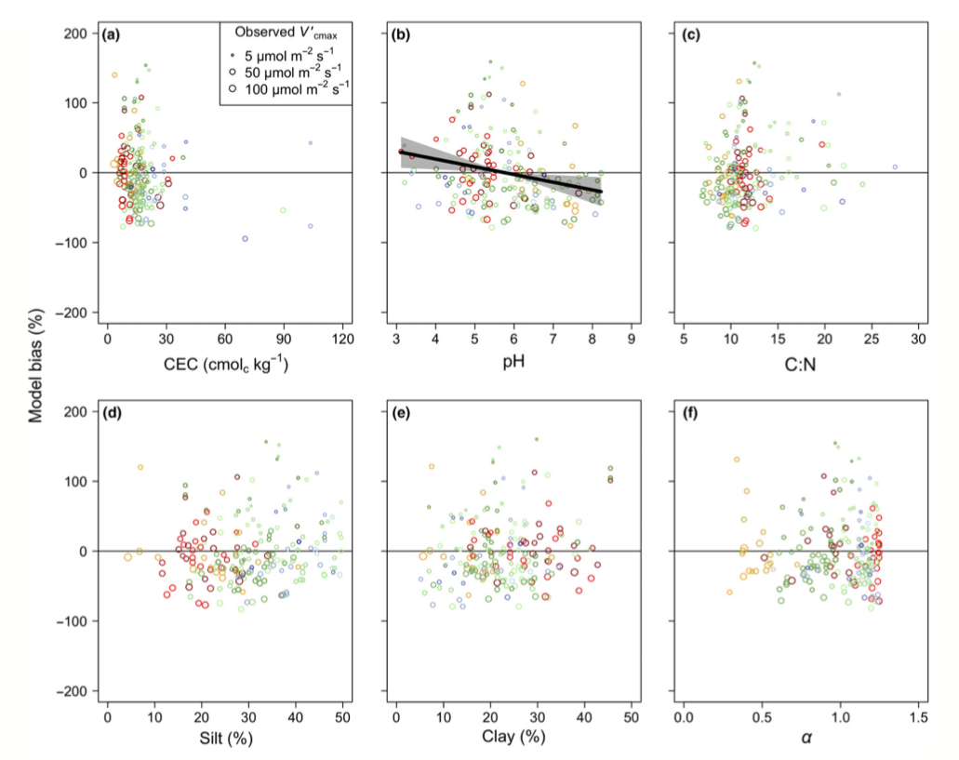
There is little effect of soils on V_{cmax}
nick.smith@ttu.edu; @nick_greg_smith
Soil increased explained variation from 64% to 68% compared to optimal response alone
Smith et al. (2019)

Slide 42
Does it work under future conditions?

Slide 43
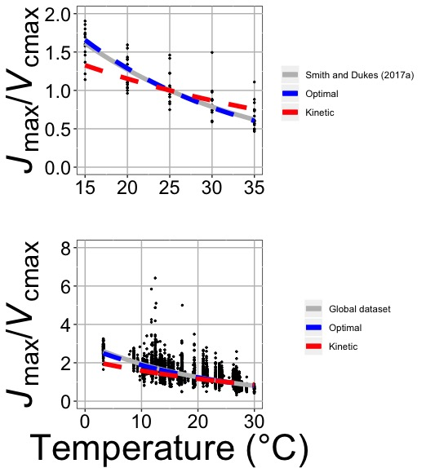
Photosynthetic traits change with temperature in ways expected from optimization
nick.smith@ttu.edu; @nick_greg_smith
Data = -0.051 °C⁻¹
Predicted = -0.048 °C⁻¹
Smith and Keenan (in review)

Slide 44
Photosynthetic traits change with future conditions in ways expected from optimization
nick.smith@ttu.edu; @nick_greg_smith
mean: -12%
mean: -15%
(P > 0.05)
Smith and Keenan (in review)

Slide 45
Implications

Slide 46
Implications
Optimal leaf biochemical setup is determined by climate

Slide 47
Implications
Optimal leaf biochemical setup is determined by climate
Plants mine for N to get the most leaves at the optimal setup

Slide 48
Implications
Optimal leaf biochemical setup is determined by climate
Plants mine for N to get the most leaves at the optimal setup
Photosynthetic demand determines leaf N, not the other way around

Slide 49
Axes need flipped
Kattge et al. (2009)

Slide 50
Implications
Optimal leaf biochemical setup is determined by climate
Plants mine for N to get the most leaves at the optimal setup
Photosynthetic demand determines leaf N, not the other way around
Soil N determines # of leaves (before canopy closure)

Slide 51
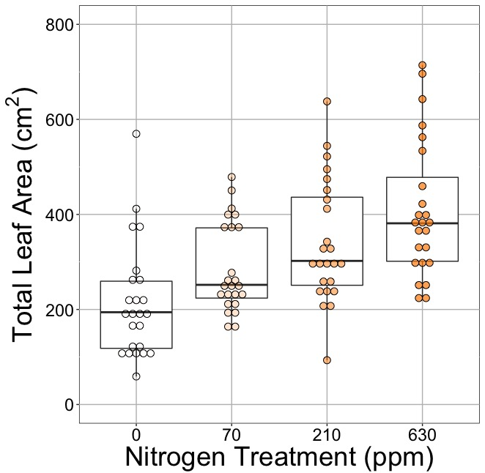
Soil N determines # of leaves?
nick.smith@ttu.edu; @nick_greg_smith
No change (P = 0.42)
91% increase (P < 0.05)
Waring and Smith (in prep)

Slide 52
Next steps: How might this effect simulated nutrient limitation?
nick.smith@ttu.edu; @nick_greg_smith
Net Photosynthesis
“No limitation” simulation
“Nutrient limitation” simulations
Leaf Nitrogen
Weider et al. (2015)
Smith et al. (in prep)

Slide 53

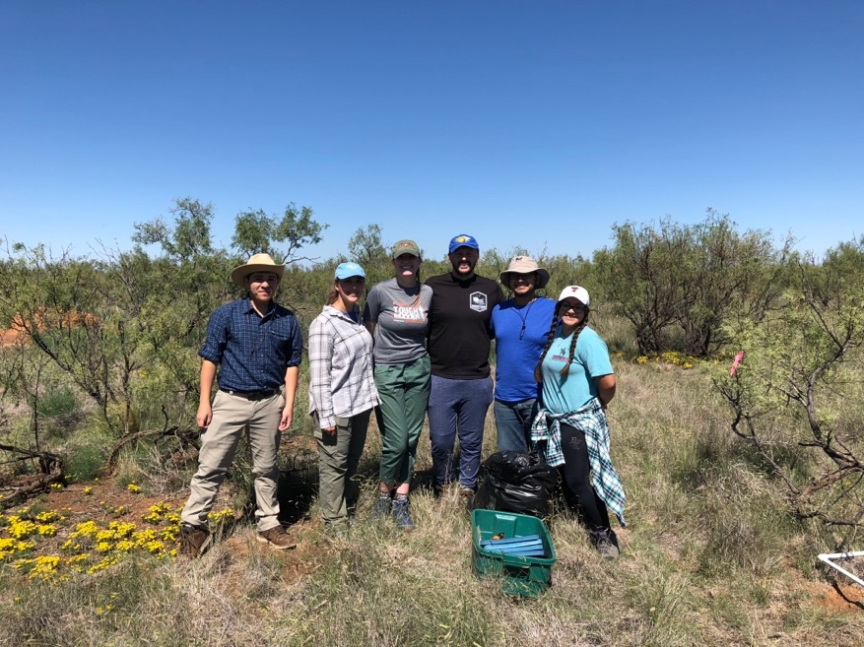
Acknowledgements
nick.smith@ttu.edu; @nick_greg_smith
Lawrence Berkeley National Lab
Bill Riley
Qing Zhu
Smith Ecophysiology Lab
Lizz Waring (now AProf at Northeastern State U)
Helen Scott (now in industry)
Evan Perkowski (PhD student)
Risa McNellis (MS Student)
Next Generation Ecosystem Modeling Group
Colin Prentice (Imperial College)
Trevor Keenan (UC Berkeley)
Wang Han (Tsinghua U)
Beni Stocker (ETH Zurich)

Slide 54
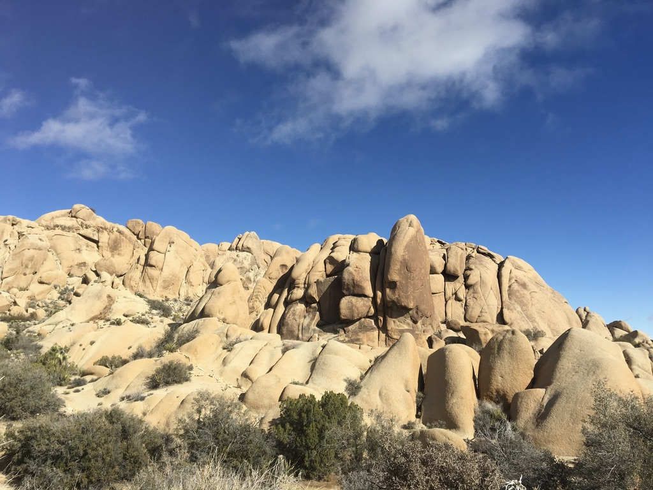
nick.smith@ttu.edu; @nick_greg_smith
Presentation available at:
www.github.com/SmithEcophysLab/seminar/lmwg_2020
Thanks!

Slide 55
Extra slides

Slide 56
Leaf area, but not photosynthesis increases with N addition
nick.smith@ttu.edu; @nick_greg_smith
No change (P = 0.42)
91% increase (P < 0.05)
Waring and Smith (in prep)

Slide 57
nick.smith@ttu.edu; @nick_greg_smith
Open stomata:
Benefits
High CO₂ influx
Costs
High water outflux
Closed stomata:
Benefits
Low water outflux
Costs
Low CO₂ influx

Slide 58
nick.smith@ttu.edu; @nick_greg_smith
Open stomata:
Benefits
High CO₂ influx
Costs
High water outflux
Closed stomata:
Benefits
Low water outflux
Costs
Low CO₂ influx
Must maintain high amount of Rubisco to do photosynthesis

Slide 59
Optimal stomatal conductance
nick.smith@ttu.edu; @nick_greg_smith
Optimal conductance maximizes photosynthesis at least water loss and nutrient use
Water loss is from transpiration
Nutrient use is nutrients used to maintain Rubisco
Rubisco proxy is V_{cmax}

Slide 60
Stomatal conductance trait The ratio of CO₂ in the leaf to CO₂ outside of the leaf (C_{i}/C_{a})
nick.smith@ttu.edu; @nick_greg_smith

Slide 61
nick.smith@ttu.edu; @nick_greg_smith
C_{i}/C_{a} = f{temperature,
CO₂,
vapor pressure deficit}
Prentice et al. (2014); Wang et al. (2017); Smith et al. (2019)

Slide 62
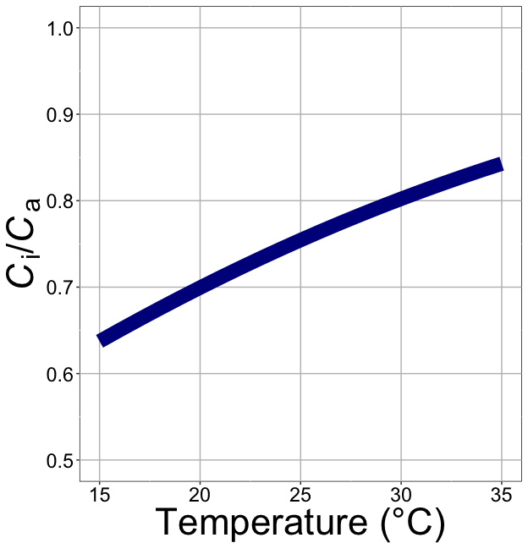
nick.smith@ttu.edu; @nick_greg_smith
C_{i}/C_{a} increases with temperature because of greater photorespiration
Smith et al. (2019)

Slide 63
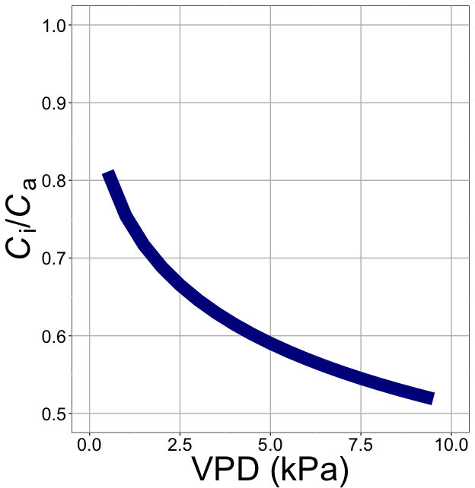
nick.smith@ttu.edu; @nick_greg_smith
C_{i}/C_{a} decreases with VPD because of greater water loss
Smith et al. (2019)

Slide 64
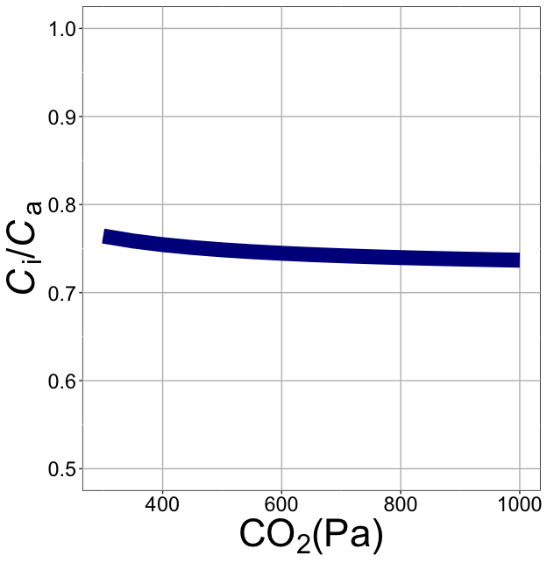
nick.smith@ttu.edu; @nick_greg_smith
C_{i}/C_{a} decreases with CO₂ because of lower openness needed to satisfy Rubisco
Smith et al. (2019)

Slide 65
Photosynthetic acclimation can be seen as the change in the instantaneous responses with longer-term exposure
nick.smith@ttu.edu; @nick_greg_smith
Acclimated to high light

Slide 66
Photosynthetic acclimation can be seen as the change in the instantaneous responses with longer-term exposure
nick.smith@ttu.edu; @nick_greg_smith
Acclimated to high light
Acclimated to low light

